Slide 1
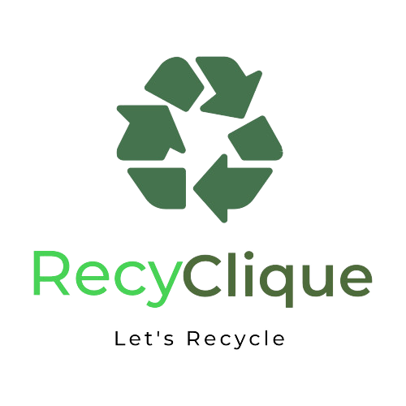

Slide 2


App Idea:
We want to redefine recycling by connecting households with industries. We collect recyclable materials from homes, facilitating their transformation into valuable resources for industries.
Our mission is to bridge the sustainability gap. By linking responsible households with eco-conscious industries.
Our goal is to empower individuals to make impactful choices, contributing to a greener future for generations to come.

Slide 3
App Glance

Slide 4
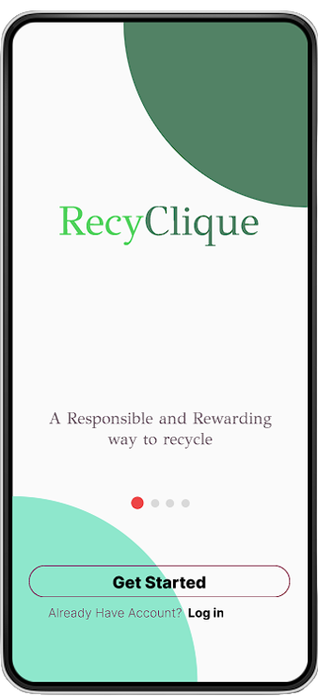
A rewarding way to recycle unused products and wastes

Slide 5
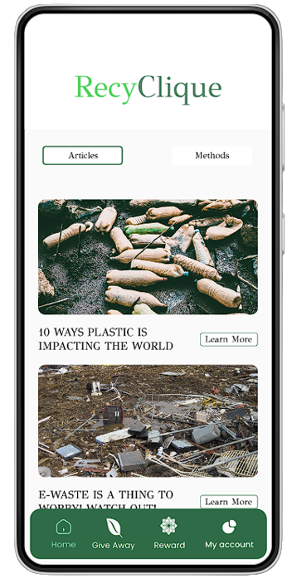
Read articles about recycling and its impact on earth

Slide 6
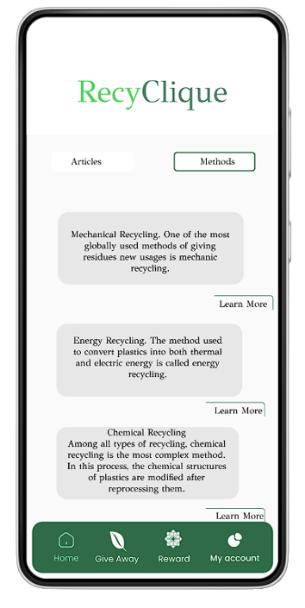
Learn new ways and methods of recycling

Slide 7
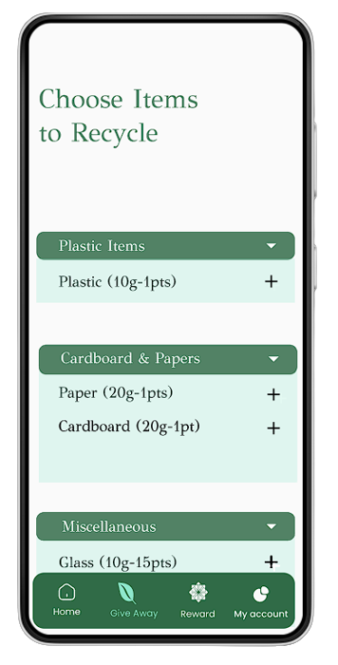
List your unused items and submit to us and get points accordingly

Slide 8
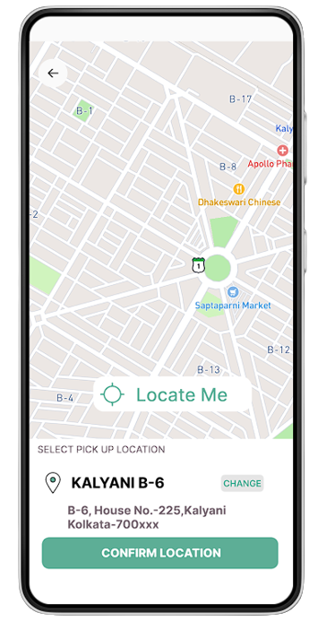
Set your location and we will pick your waste according to your address

Slide 9
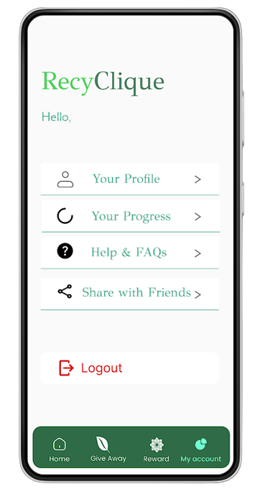
Get rewarded with your received points!

Slide 10



THANK YOU

